Slide 1
Archetype Analysis on Multiomic Data
April 5, 2023

Slide 2
Part 1A: Unsupervised AA on imputed M2

Slide 3
Unsupervised AA on M2 showed 5 archetypes
I previously ran this (and forgot– oops) on my version of M2.
Preprocessing done in Python (Scanpy)– code in Github/notebooks/M2 (Notebook 2a):
No batch correction (no M1)
Data imputation with MAGIC
Doublets not removed (these were also not removed from Debbie’s data)
UMAP coordinates from Debbie’s analysis
AA using PyPCHA
Top 8 PCs , delta = 0
K in [3,10] tested; 5 archetypes was the knee of the EV fraction plot

Slide 4
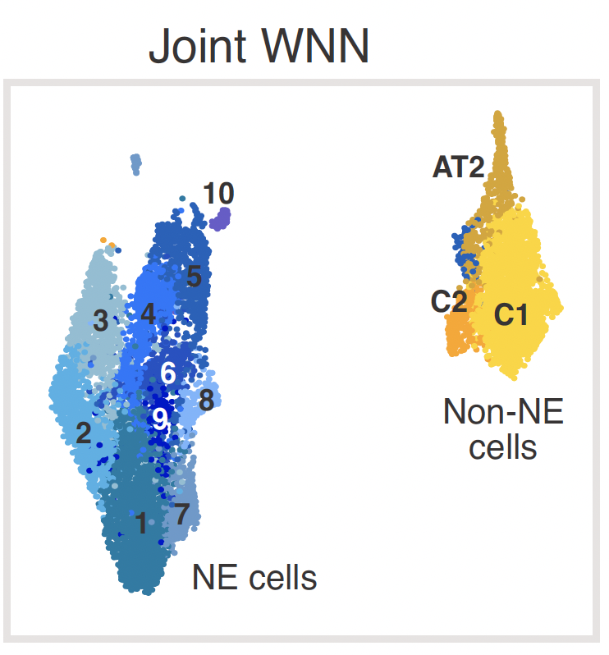
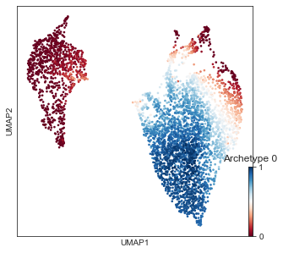
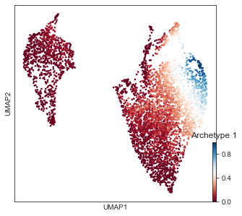
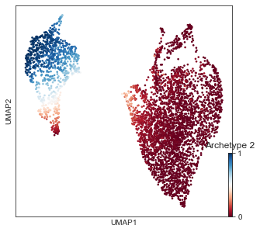
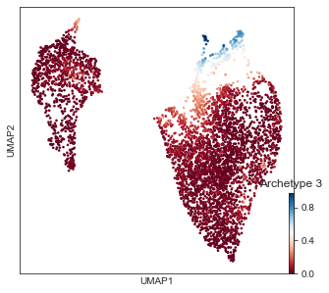
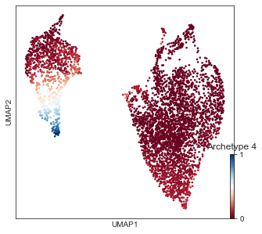
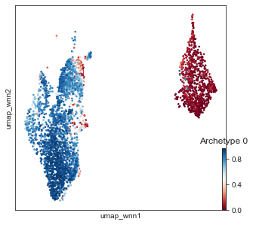
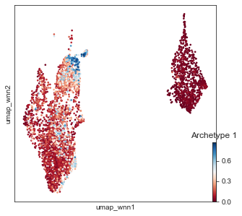
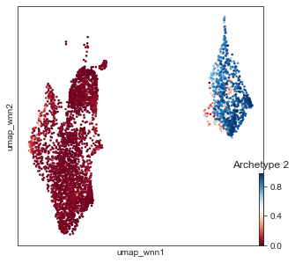
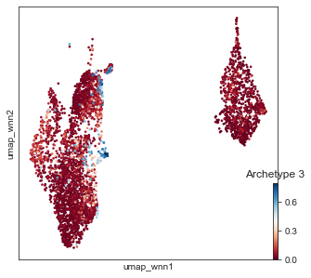
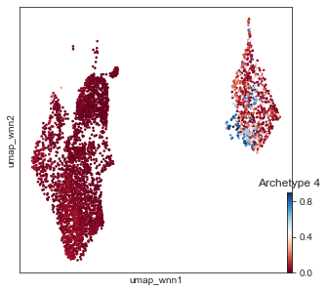
Unsupervised AA on M2
2 non-NE archetypes, 3 NE archetypes
When overlaid on Debbie’s UMAP, the NE archetypes mostly match up with NE 10/11, NE 8, and NE 1

Slide 5
Thoughts about the results
I can’t replicate this analysis on the full dataset without doing some kind of batch correction between M1 and M2
I could use Debbie’s Harmony-corrected data, but the analysis would not be on a PCA
I could do the same exact analysis on M1 separately, and project the archetypes onto Debbie’s UMAP to see if they match up with M2, but this might be confusing for the audience
I can combine the datasets without batch correction and do this method

Slide 6
Part 1B: Supervised AA on imputed M2

Slide 7
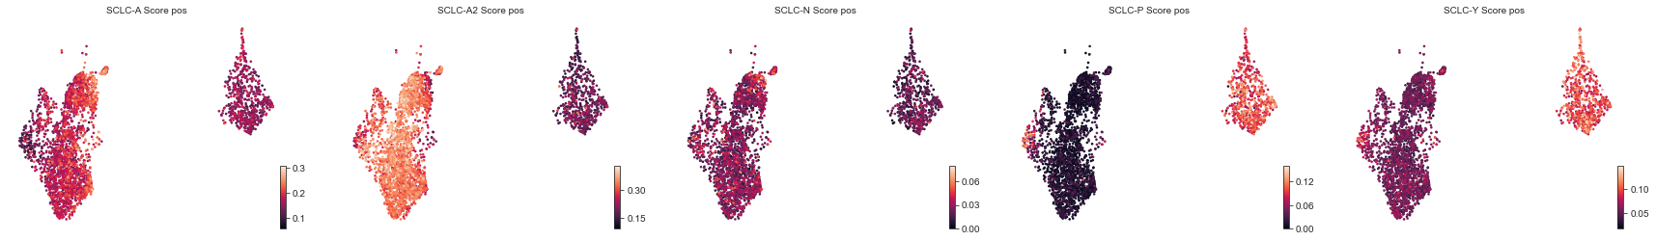
Supervised AA Scores
The highest A score is around NE 10/11
The rest of the NE cells are pretty high for A2
Sporadic (low) scores for N
P is high at NE 2 and 3 (see next slide)
Y is high in non-NE cells, but not as high as expected
From Notebook 3 on M2

Slide 8
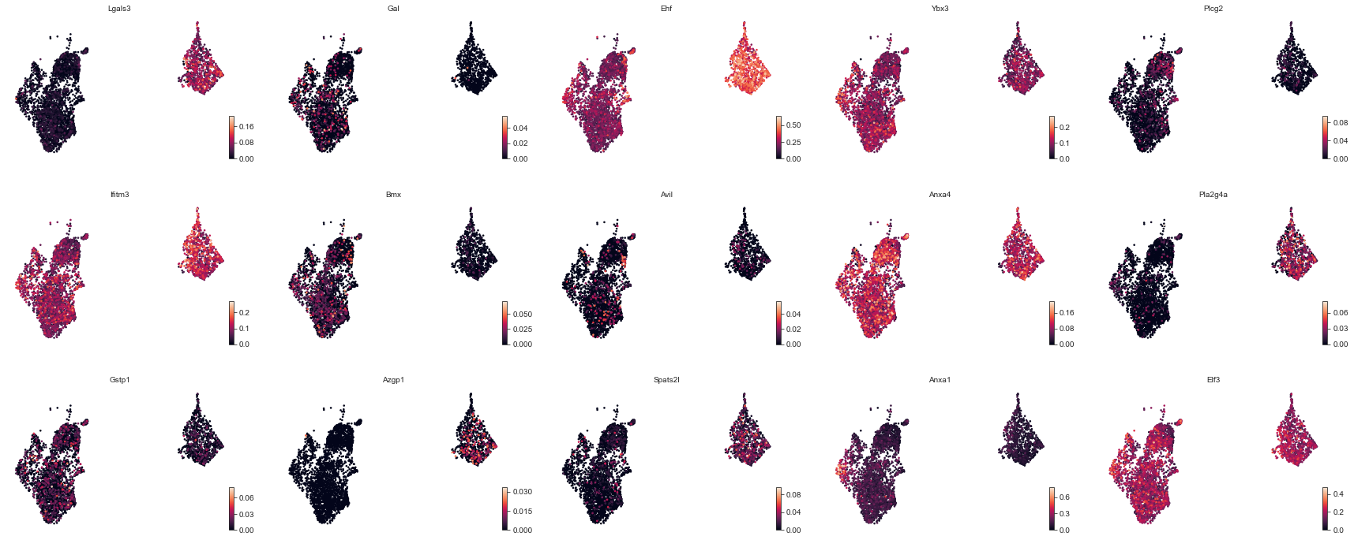
SCLC-P Genes
Expression of ANXA1 is driving the higher P score (and maybe Elf3)

Slide 9
Part : Unsupervised AA on imputed M1

Slide 10
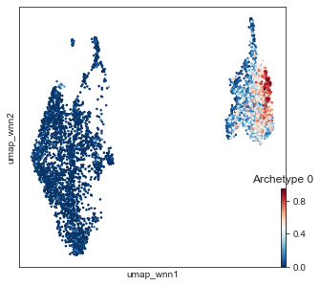
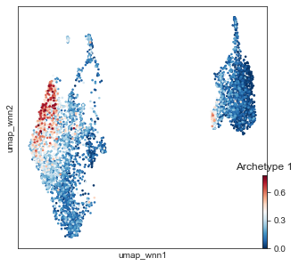
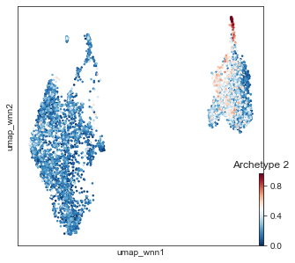
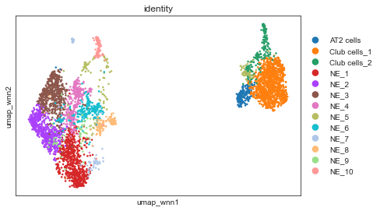
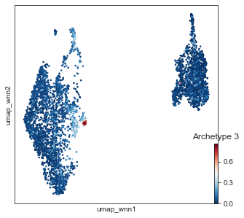

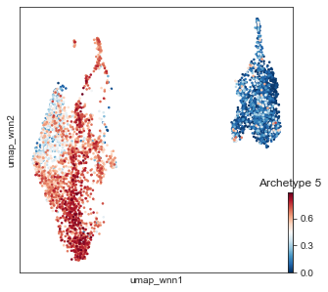

Slide 11
Thoughts about M1 archetypes
When overlaid on Debbie’s UMAP, the NE archetypes match up with NE2/3, a tiny archetype matches NE8, and most of the NE cells are close to an NE1 archetype
There are also three non-NE archetypes, but they don’t really match up with the three clusters

Slide 12
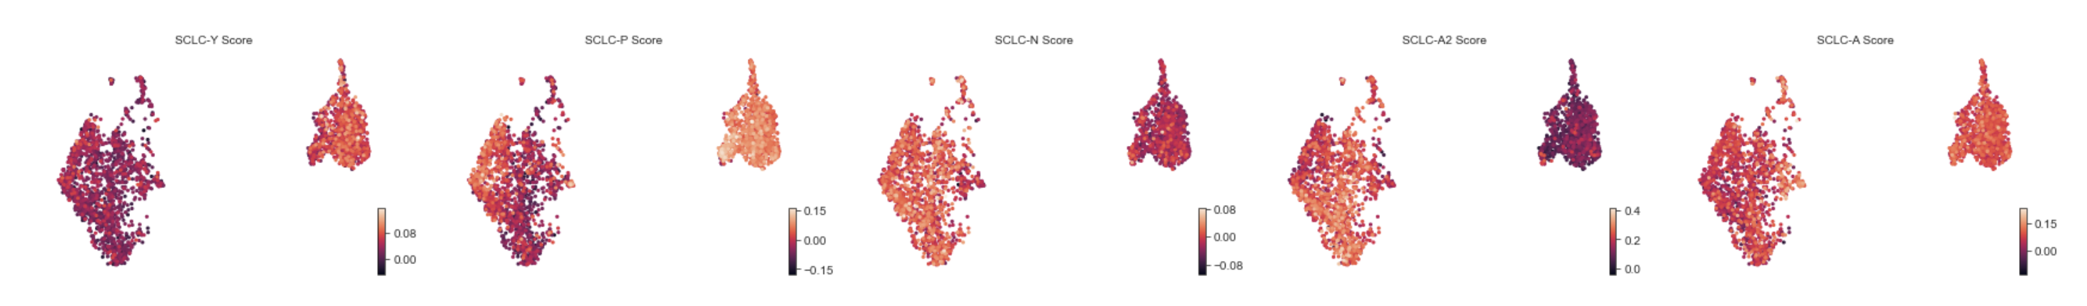
M1 supervised
A2 is still dominating NE cells
P is slightly higher on left NE cells

Slide 13
Summary so far
M2 captures three NE archetypes: top, right, and bottom
M1 also captures three archetypes: left, right, and bottom
Supervised AA on M2 suggests that the left archetype is P-like (mostly due to high ANXA1 expression)
This might be difficult to make clear in a manuscript, but gives me hope that we can make something work for referencing the vertices of the UMAP
Then we could label the cells based on distance from:
Top: Metastatic, NFIB
Left: ANXA1+, less NE, JUN/FOS motif activity
Bottom: Classic NE, ASCL1+, A2-like
Right: Highly cycling, less NE, JUN+ (RNA)

Slide 14
AA on combined dataset

Slide 15
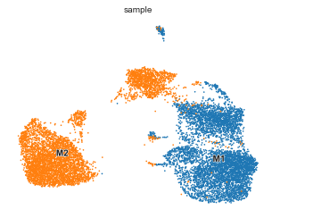
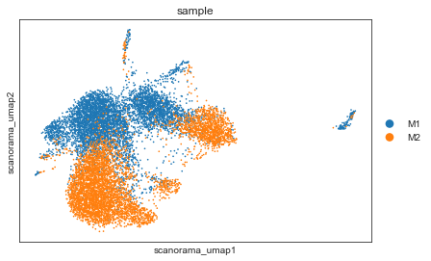
Preprocessing
Similar preprocessing as for individual datasets
Scanpy filters cells and genes (min_genes = 100, min_counts = 3)
Normalize total, log1p
Batch correction with scanorama doesn’t do much
AA is run on MAGIC imputed data without scanorama correction

Slide 16
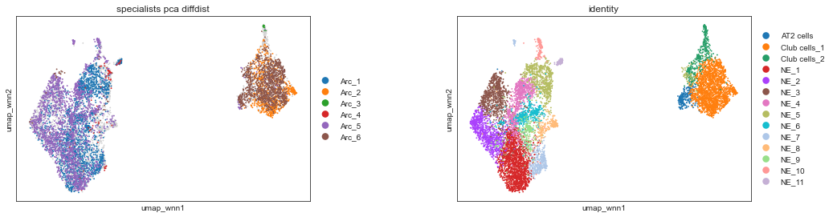
Specialists based on diffusion distance to archetypes in PCA space
On the magic imputed, combined dataset (not batch corrected), 6 archetypes are found
These don’t translate very well to the UMAP (as expected)

Slide 17
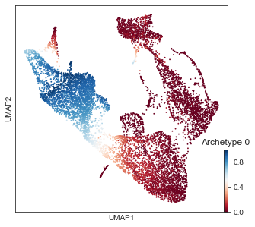
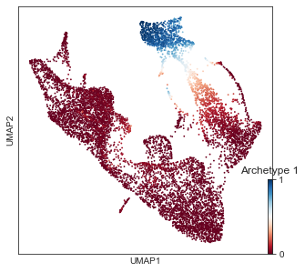
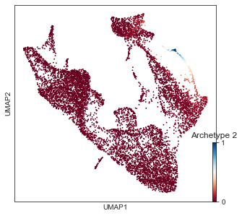
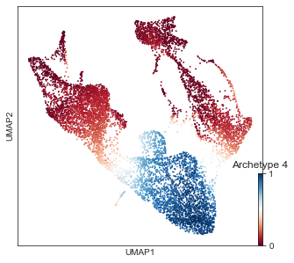
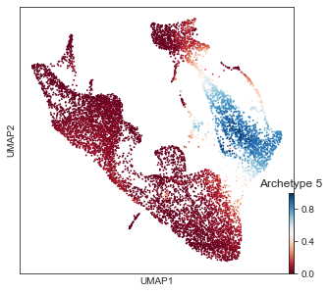
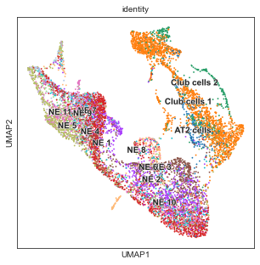
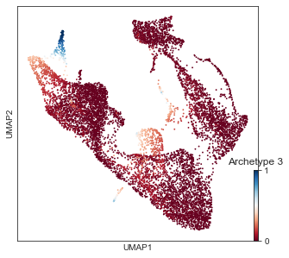
Archetype scores on UMAP (computed on MAGIC imputed dataset)

Slide 18
AA on Harmony Reduction of Combined Dataset

Slide 19
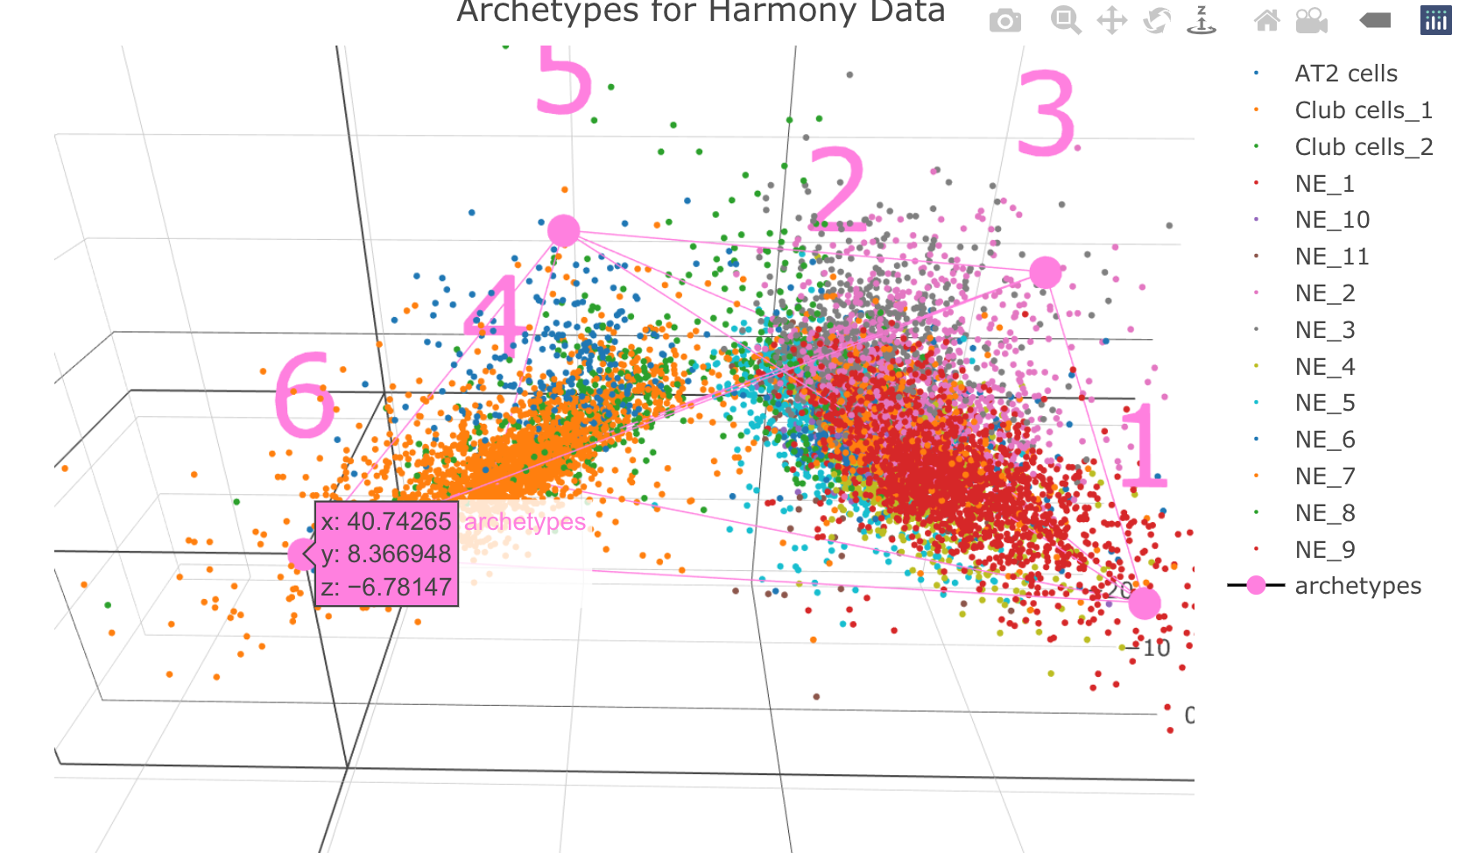

Slide 20
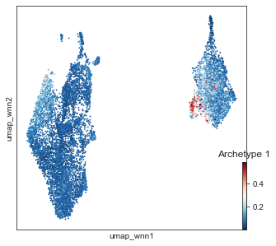
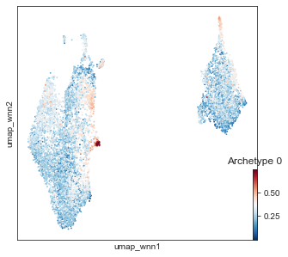
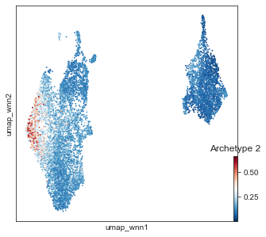
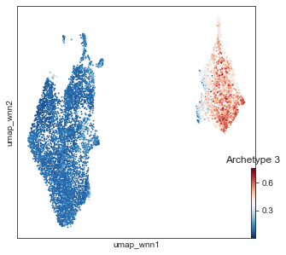
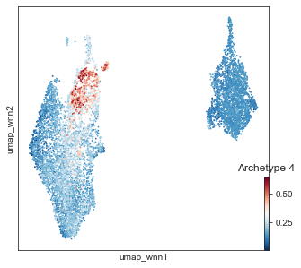
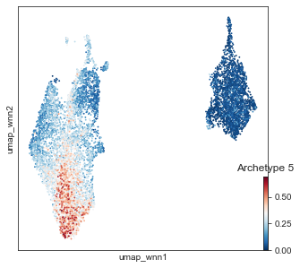

Slide 21
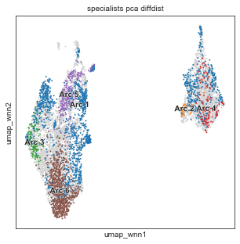
Labeled by diffusion distance

Slide 22
Appendix A: Old analysis unsupervised AA on M1

Slide 23
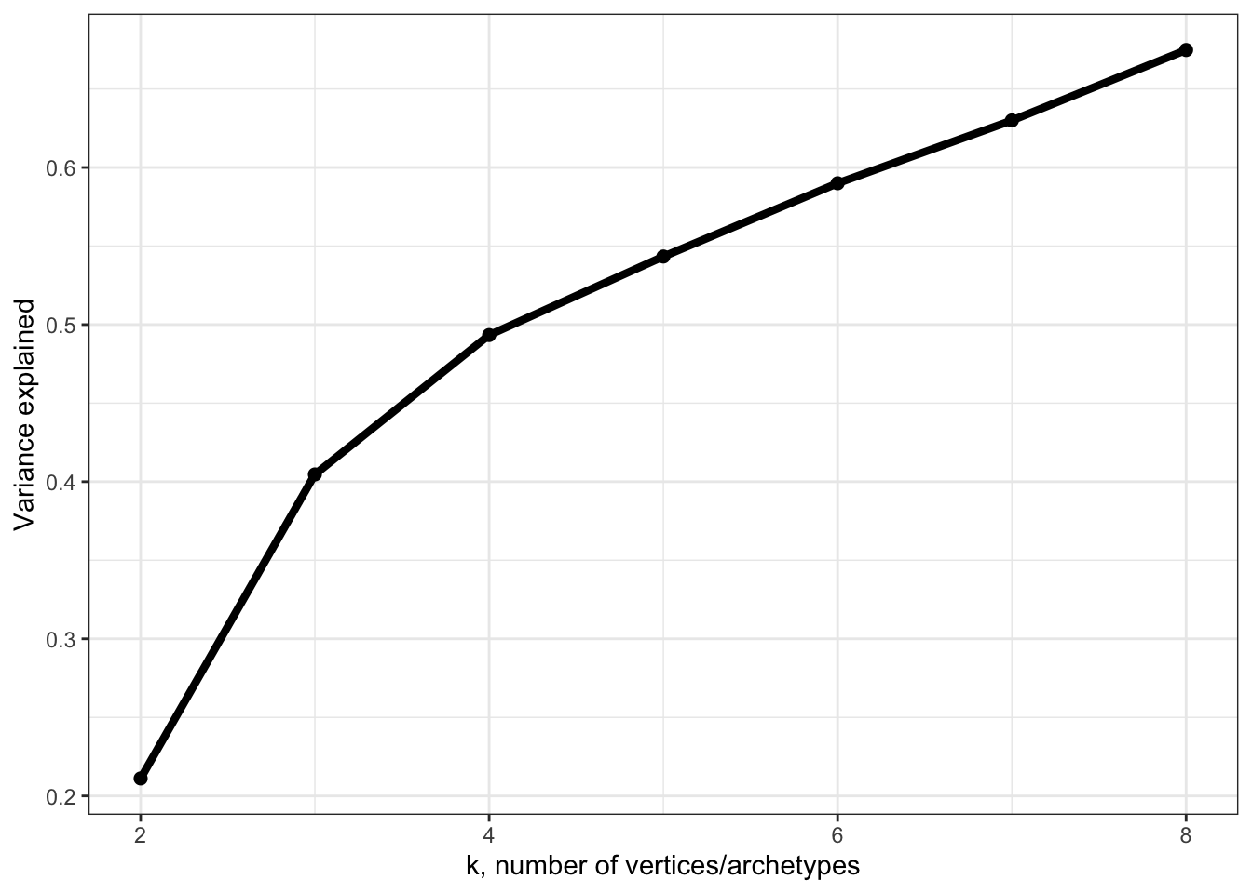
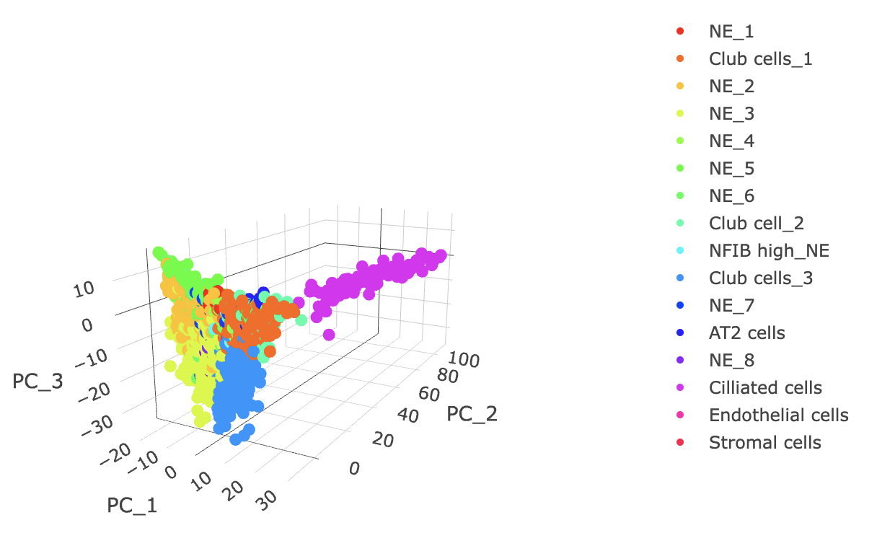
Unsupervised AA on M1 using ParetoTI
ParetoTI on original TKO.rds (before M2 was generated)
Used pca-embedding from Debbie’s analysis (my notes say that this was a PCA using the SC Transformed scaled.data)
We now know that the SCT values are weirdly cutoff, so maybe this was why the AA didn’t look great
4 seemed good from explained variance; a look at the PCA shows that the ciliated cell population dominated PC2, so that was removed
file:///Users/smgroves/Documents/GitHub/multiome-analysis/archetype-plasticity-notebooks/M1/plots/pca_full_dataset_4_archetypes.html

Slide 24
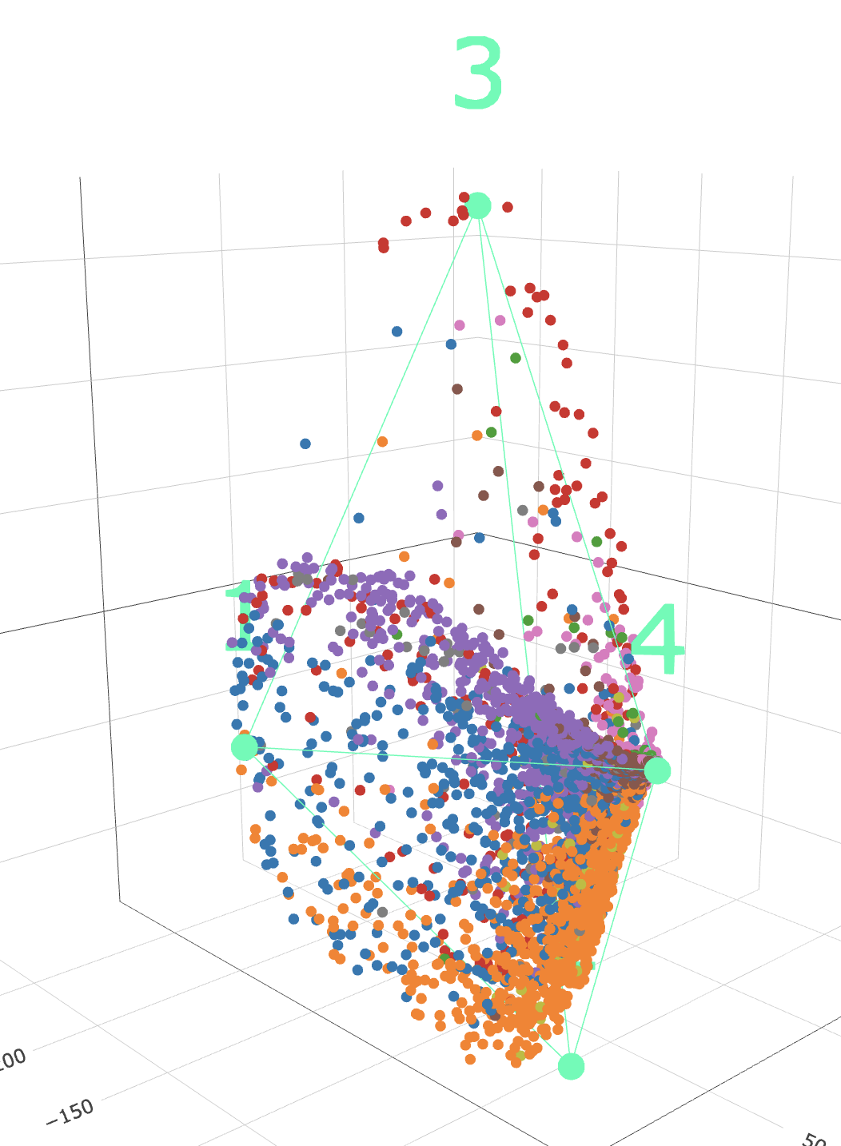
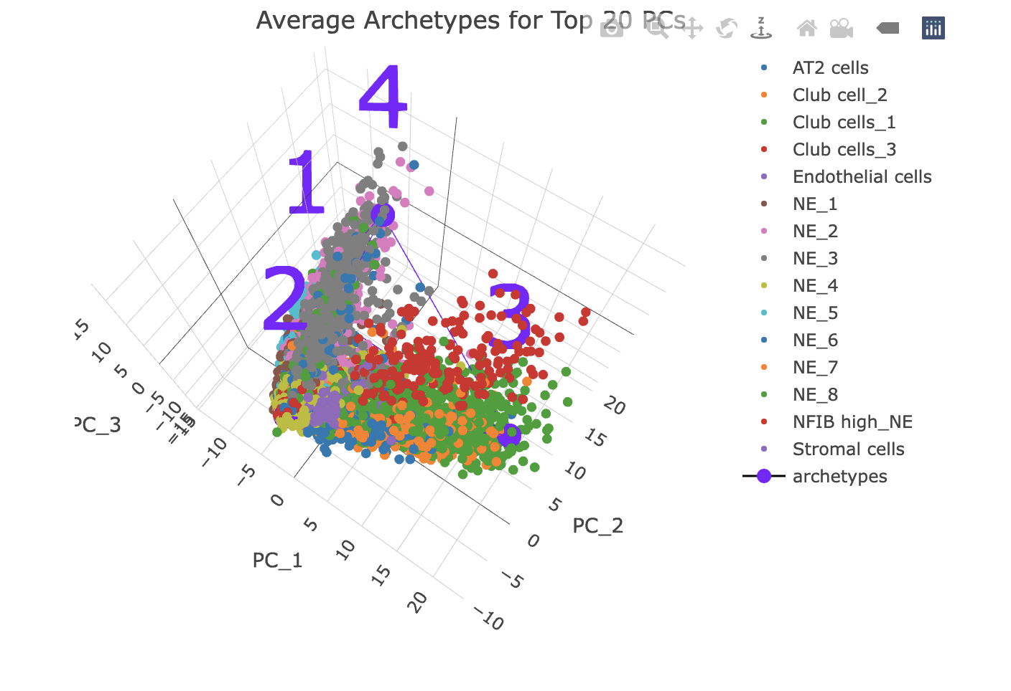
With ciliated cells removed, we got a butterfly shape
Often this shape comes from strange preprocessing (e.g., if doing AA on raw counts, there is a lower limit of 0, so all of the cells will have a hard, non-biological cut off in this space that might show up as an archetype)
On NE cells only, we still go the weird shape
file:///Users/smgroves/Documents/GitHub/multiome-analysis/archetype-plasticity-notebooks/M1/plots/NE_clusters_arc_space.html

Slide 25
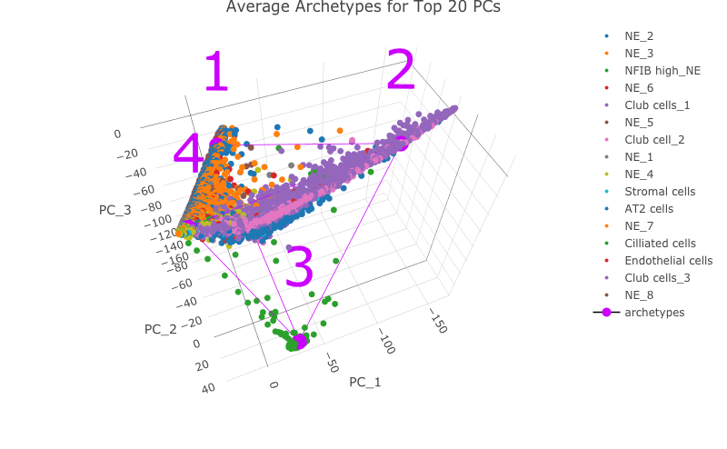
I also tried on imputed data with MAGIC, which gave the same restriction

Slide 26
Appendix B: Old analysis supervised AA on M2

Slide 27
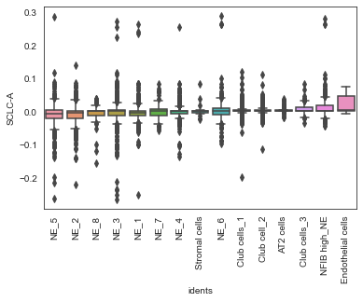
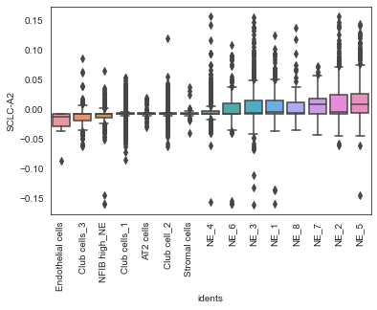
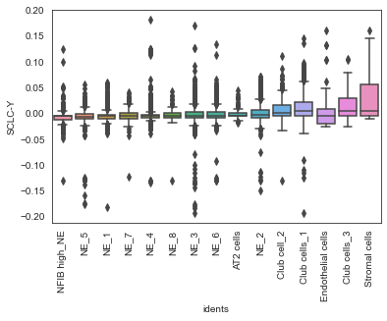
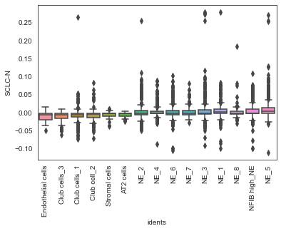
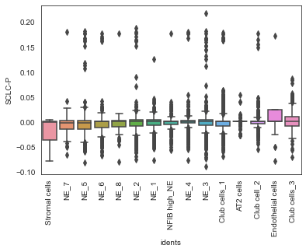
Supervised AA on M2

